Slide 1
Machine Learning
Gradient Descent Algorithm
Linear Regression
Non-Linear Regression
Logistic Regression
Decision Trees
Regression Trees
Classification Trees
Clustering Algorithms
K-Means
Hierarchical clustering
DB-Scan
Mean Shift
GMM
Support Vector Machine
Deep Learning
MLP
CNN
Datasets
Breast Cancer Wisconsin
MIMIC-III
Framingham Heart Study
Alzheimer’s Disease Neuroimaging Initiative
Drug discovery
Microbiome

Slide 2
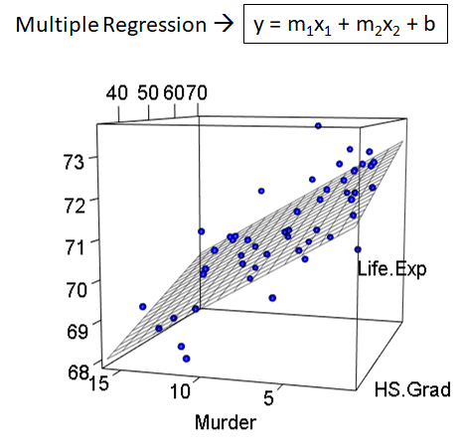
C2 – Multivariable Linear Regression
my humble ML course

Slide 3
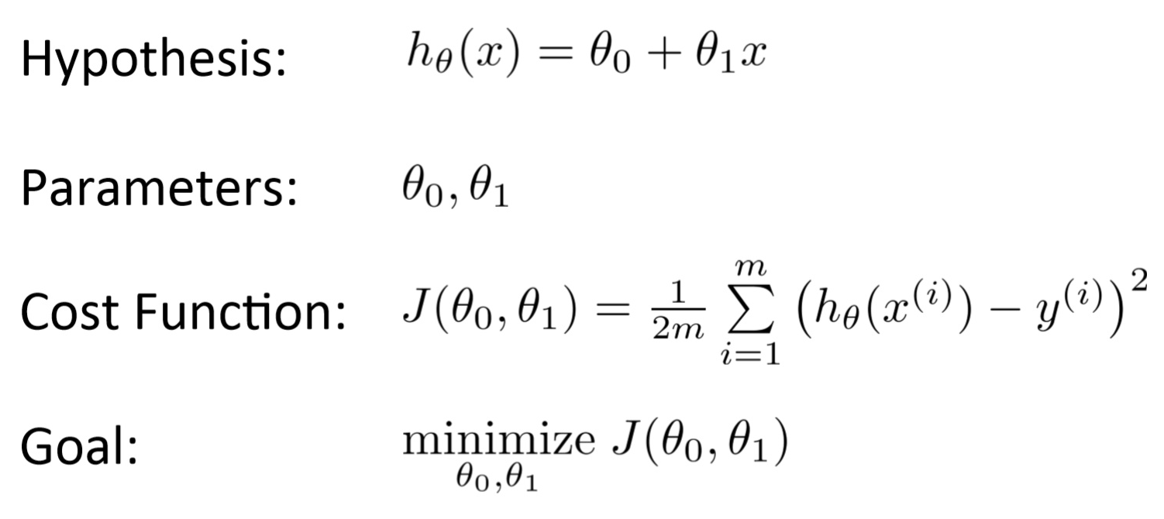
my humble ML course
Univariable Linear Regression
gradient descent

Slide 4
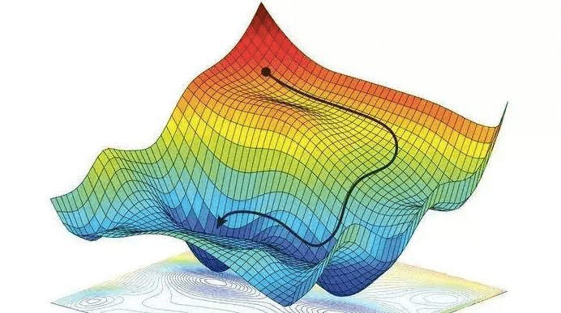
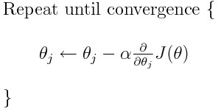

my humble ML course
(Vanilla) Gradient Descent
First-order optimization algorithm to find a local minimum/maximum of a given function.
Only two specific requirements (differentiable, convex).
$$p_{n+1}=p_{n} − η∇ f\left(p_{n}\right)$$
Convergence is determined by two ways: max_iter, tol.
Tradeoff smaller/greater learning rate.

Slide 5
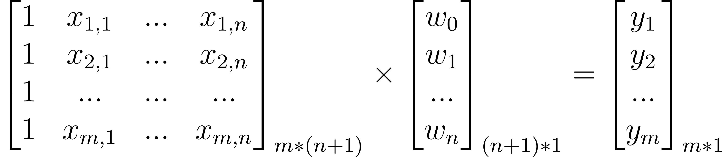
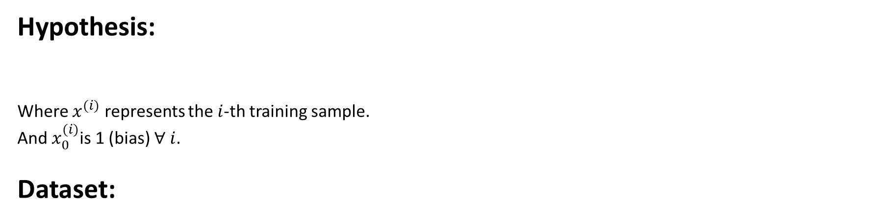
my humble ML course
Multivariable Linear Regression
Hypothesis:
Where $x^{(i)}$ represents the $i$-th training sample.
And $x_{0}^{(i)}$is 1 (bias) $∀ i$.
Dataset:
training samples
bias
features

Slide 6
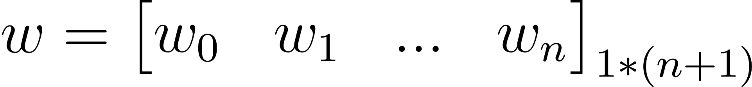
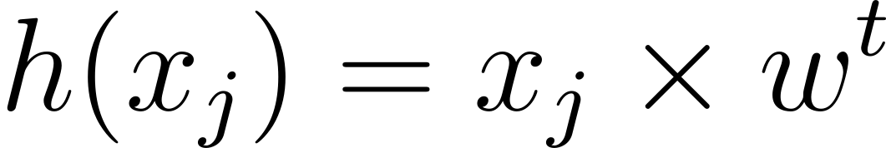
my humble ML course
Multivariable Linear Regression
Hypothesis:
Parameters:
Prediction:

Slide 7
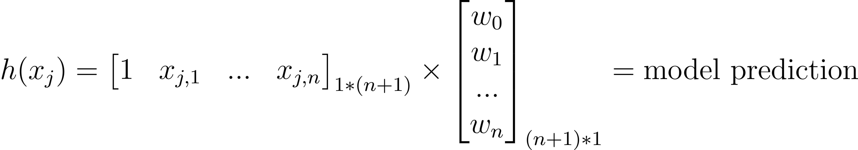
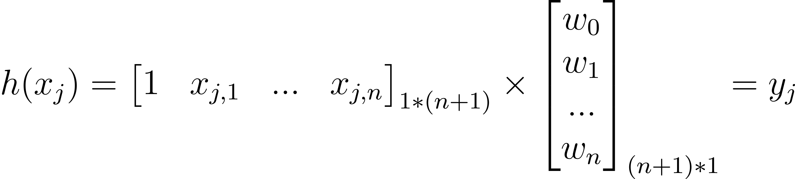
my humble ML course
Multivariable Linear Regression
.

Slide 8

my humble ML course
Multivariable Linear Regression
Given $m$ training samples.
And update parameters via gradient-descent algorithm minimizing the loss function (MSE).

Slide 9
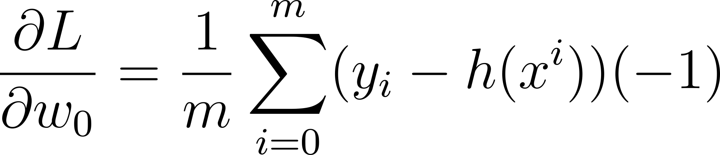
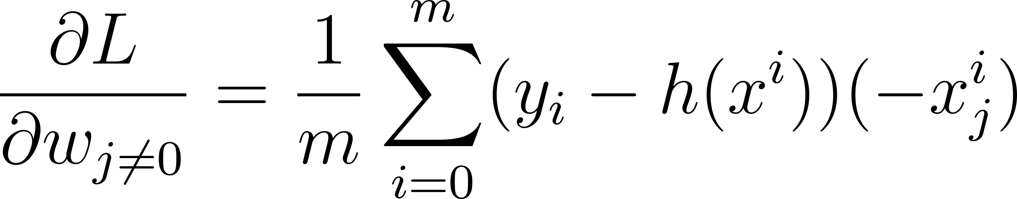
my humble ML course
Multivariable Linear Regression
Update parameters via gradient-descent algorithm

Slide 10
C2 – Non - Linear Regression
my humble ML course
Notes:
https://www.analyticsvidhya.com/blog/2021/06/linear-regression-in-machine-learning/

Slide 11
my humble ML course
Bibliography
https://towardsdatascience.com/multiple-regression-as-a-machine-learning-algorithm-a98a6b9f307b
Notes:
https://towardsdatascience.com/gradient-descent-algorithm-a-deep-dive-cf04e8115f21
https://towardsdatascience.com/all-machine-learning-models-explained-in-6-minutes-9fe30ff6776a
https://medium.com/grabngoinfo/gradient-descent-vs-616ba269de8d

Slide 12

my humble ML course
Code
Notes:
https://github.com/kamperh/data414

